Slide 1


LoRaTrimmer: Optimal Energy Condensation with Chirp Trimming for LoRa Weak Signal Decoding
Jialuo Du¹, Yunhao Liu¹ , Yidong Ren², Li Liu¹, Zhichao Cao²
¹Tsinghua University ²Michigan State University

Slide 2







Background
A large IoT network with IoT nodes in a large area…
IoT node
IoT node
IoT node
IoT node
Wireless Protocol Designed for Weak Signal Decoding
This work: Push the limits of Weak Signal Decoding
Long Range
Notes:
LoRa is the Wireless Protocol Designed for Weak Signal Decoding, and this work is to push the limits of Weak Signal Decoding

Slide 3
Ideal LoRa Symbols
f
f
f
f
B
Chirp
B
B
×
=
FFT
Signal
Encodes
Data
f₀
f₀
f₀
t
t
t
Energy
0
0
0
0
Noise
-B
Ideal LoRa Symbol
Dechirp
Singletone
FFT result
Condense energy, decode weak signal
Notes:
Ideal Lora symbols are chirps whose frequency increase at a constant rate with time, and its initial frequency encodes the data. In standard LoRa demodulation, we multiplies it with a downchirp, and the result is a singletone signal, thus we condense the power of the whole signal into one frequency, and noise is scattered throughout the bandwidth, that’s how we decode weak signals.

Slide 4
Real LoRa symbols
Out of Band
f
f
B
B
Freq.
Jump
f₀
f₀
Freq.
Jump
Freq.
Jump
f₀
f₀
f₀
t
f₀
t
0
0
Ideal LoRa Symbol
Real LoRa Symbol
Freqency Jump Cause Problems!
Notes:
However, the real lora symbols are different. The out of band part of the idea signal is wrapped inside the band, so there is a frequency jump inside each symbol, different symbols have different frequency jump locations, and this causes problems.

Slide 5

Problems of Standard Demodulation
Out of Band Noise
f
f
B
B
FFT
FFT
Destructive Add
Energy Loss
Freq.
Jump
f₀
f₀
FFT
Energy
Energy
0
0
f₀ - B
-B
Ideal Symbol Demodulation
Real Symbol Demodulation
Notes:
During demodulation. the ideal symbol generates one peak, containing all the signal power. However, in real symbols, if we still use the same demodulation method, It will generate two peaks, one for each section. Each peak contains only a part of the power. Furthermore, due to hardware imperfections, the frequency jump is also accompanied by a phase jump. This makes the two peaks have different phases, so if we directly add them together,they will distructively add, leading to energy loss.
Another problem is, to detect the two peaks, we have to expand the detection area to twice the bandwidth. This makes the perception range of the FFTs wider than bandwidth, inducing out of band noise, lowering the signal to noise ratio. Although we can reduce this out of band noise by low pass filters, the filters are non-ideal cannot remove all of the noise, so this will also impact the noise resistance.

Slide 6
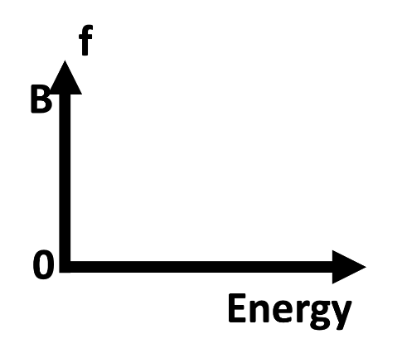
Key Designs
Original Demodulation
LoRaTrimmer
Divide into 2 parts
before and after jump
f
B
Trim
Freq.
Jump
FFT1
f₀
Energy
FFT2
0
Trim
f₀ - B
Use Prob. Model
Constructive Add
No Energy Loss
Notes:
To tackle the two problems, Our key idea is to modify the perception range of FFT. First, we divide the time-frequency space of the symbol into two parts, and perform two FFTs on them, each dealing with one part. Second, we trim the perception ranges of the two FFTs, removing out of band noise. This way, each FFT will generate one power peak. We then use probablitic modelling to constructively add the powers of the two FFT results, which will have no energy loss.

Slide 7
Design 1:Trimming perception range
The original FFT performed on full signal
Induces
out of band noise
f₁
f
Full FFT Induce Noise
f₀
f₂
B
Energy
Jump!
f₀
t
0
0
f₂
f₀
f₁
f
peak1
peak2
Notes:
The first key design of our method is trimming the perception range of FFTs to remove the extra out of band noise. If we perform FFT on the full length of the signal, the perception ranges are the blue rectangles, and they’re longer than the signalso they induce out of band noise. Our design is to split the signal in the time domain at the frequency jump, and deocde them separately. This way we cast the out-of-band part to zero, thus completely removing the out-of-band noise, effectively trimming the perception range. However, another problem arise here: we do not know the position of the frequency jump before decoding the signal. There are SF power of two symbols each having a different jump location, but the key observation is that the initial frequency of the symbol corresponds to the jumping location. so we try all SF power of two frequencies and their jumping locations. When we split at a certain location, we are hypothesizing that this is the given symbol so we only compute power of that frequency. We split at L zero, we compute power at f zero, we split at L one, we compute power at f one, etc. We’ll get a power for each symbol, and we pick the highest as our demodulation result.

Slide 8
Design 1:Trimming perception range
Trim input for FFT
to avoid extra noise
Where to trim? Jump location corresponds to freq!
Try 2^{SF} jump locations and for each location,
only compute power at its corresponding frequency
f
f₁
f₀
f
f₂
B
L₁
L₀
L₂
B
Freq.
Jump
Freq.
Jump
Freq.
Jump
f₀
Jump!
Energy
f₀
f₀
t
f₀
t
0
0
0
f₂
f₀
f₁
f
Real LoRa Symbol
FFT1
FFT2
Notes:
The first key design of our method is trimming the perception range of FFTs to remove the extra out of band noise. If we perform FFT on the full length of the signal, the perception ranges are the blue rectangles, and they’re longer than the signalso they induce out of band noise. Our design is to split the signal in the time domain at the frequency jump, and deocde them separately. This way we cast the out-of-band part to zero, thus completely removing the out-of-band noise, effectively trimming the perception range. However, another problem arise here: we do not know the position of the frequency jump before decoding the signal. There are SF power of two symbols each having a different jump location, but the key observation is that the initial frequency of the symbol corresponds to the jumping location. so we try all SF power of two frequencies and their jumping locations. When we split at a certain location, we are hypothesizing that this is the given symbol so we only compute power of that frequency. We split at L zero, we compute power at f zero, we split at L one, we compute power at f one, etc. We’ll get a power for each symbol, and we pick the highest as our demodulation result.

Slide 9
Design 2: Constructive add
Unknown
Phase diff
Recv. Signal
=
f₀
f₀-B
A
A
Theo. Signal
φ₁
φ₂
+
+
+
AWGN Noise
Noise
FFT1
FFT2
Prob. Modelling: Joint distribution of 4 vars
Marginal Dist. Of f₀ ∝|FFT1|²+|FFT2|²
Notes:
The second key design is constructive addition of the two sections of signal. The received signal equals the theoretic signal plus the AWGN noise, and The theoretic signal is a function over Amplitude, frequency, and initial phase, the noise follow gaussian distribution, so it’s a joint distribution. Since we want f zero for decoding, we compute its marginal distribution from the joint distribution by integrating over the other three variables, This simplifies into the sum of the squared absolute values of the two FFTs.
Since there is an unknown phase difference between the two sections of symbol, and this phase difference is very hard to measure accurately under low SNR, We use another approach: merging the power without knowing the phase diff. We hypothesize that the noise is only additive gaussian white noise, AWGN. So The received signal equals the theoretic signal plus the AWGN noise. The theoretic signal is a function over Amplitude, frequency, and initial phase, so we can represent them with f zero, A, phi one, phi two. the noise follow gaussian distribution. So given a received signal, we can perform probabilistic modelling on the joint distribution of the four variables. Since we want f zero for decoding, we compute its marginal distribution from the joint distribution by integrating over the other three variables. This simplifies into the sum of the squared absolute values of the two FFTs. This formula can optimally utilize the given information and constructively add up power from the two parts, without relying on an unreliable estimation of the unknown phase difference.

Slide 10
Implementation: End2End Demodulation System
Packet Detection
Payload Decoding
Detection
Window
f
f
B
B
f₀
t
t
0
Freq.
Jump
0
Freq.
Jump
LoRa Preamble
LoRa Payload Symbol
Time Complexity: O(N^{1.5})
Notes:
We implement and end2end lora demodulation system including packet detection and payload decoding.
N to the power of one point five slightly larger than n log n of FFT.
The packet detection part is similar: when the detection window misaligns with the preamble symbols, there will also be a frequency jump and two parts of signal, and they can be detected similarly. Furthermore, we reduce the time complexity of demodulating each symbol to n squared one point five, which is only slightly larger than n log n of FFT. Our method is very efficient and powerful.

Slide 11
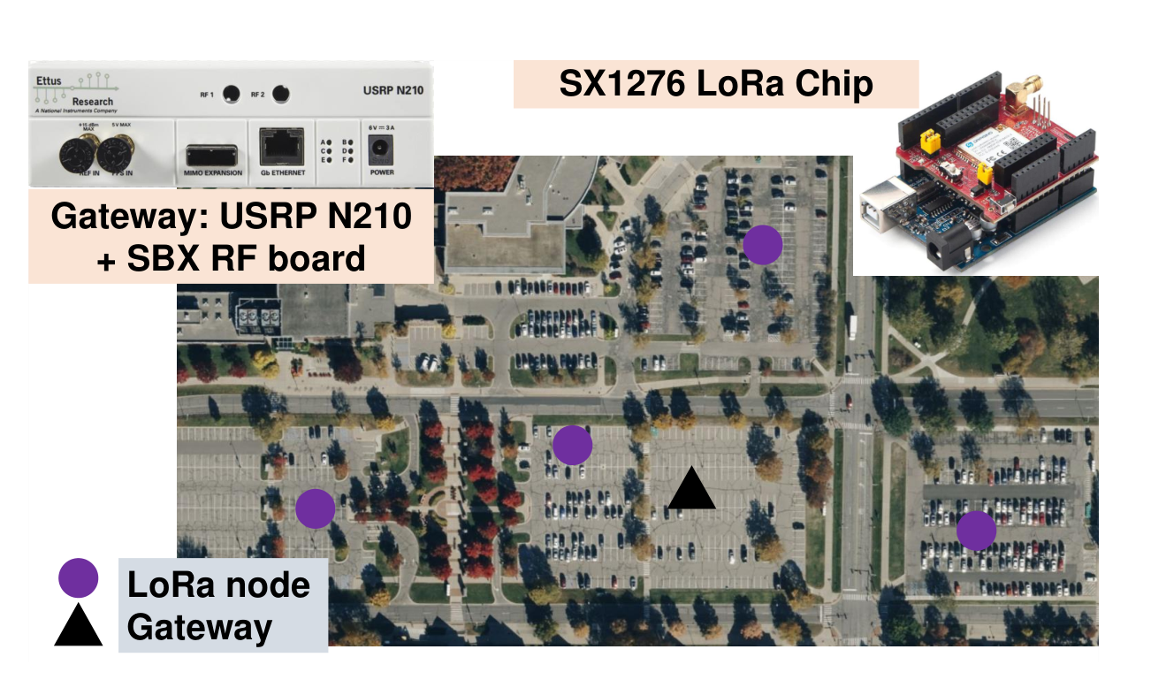
Hardware Implementation
Notes:
We deploy our system with custom off-the-shelf devices and deploy them indoors and outdoors.

Slide 12
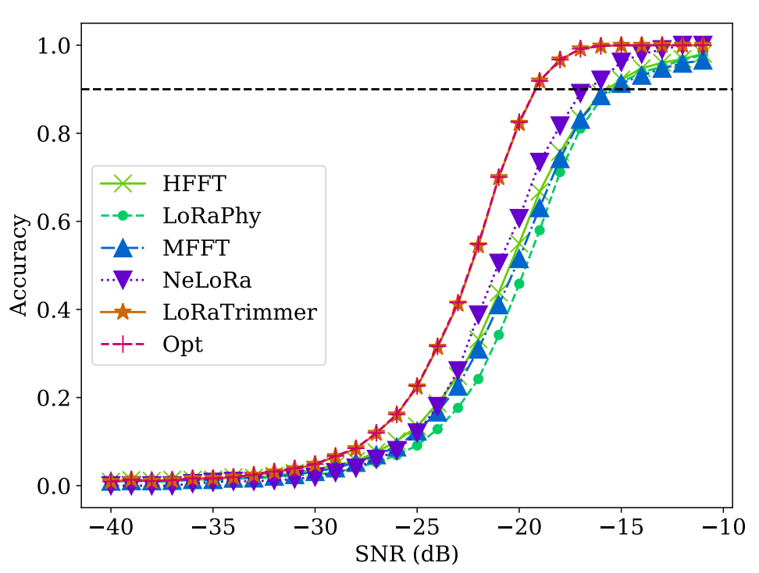
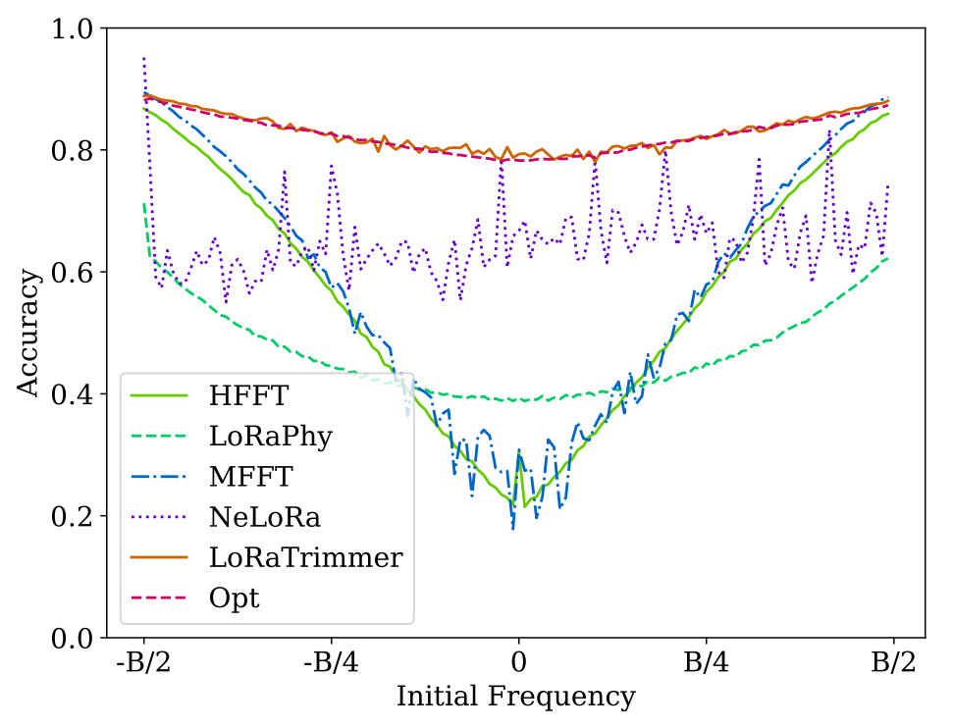
Evaluations
Highest Noise Resistance 3.44~3.79 dB SNR Gain
Robust Performance

Slide 13
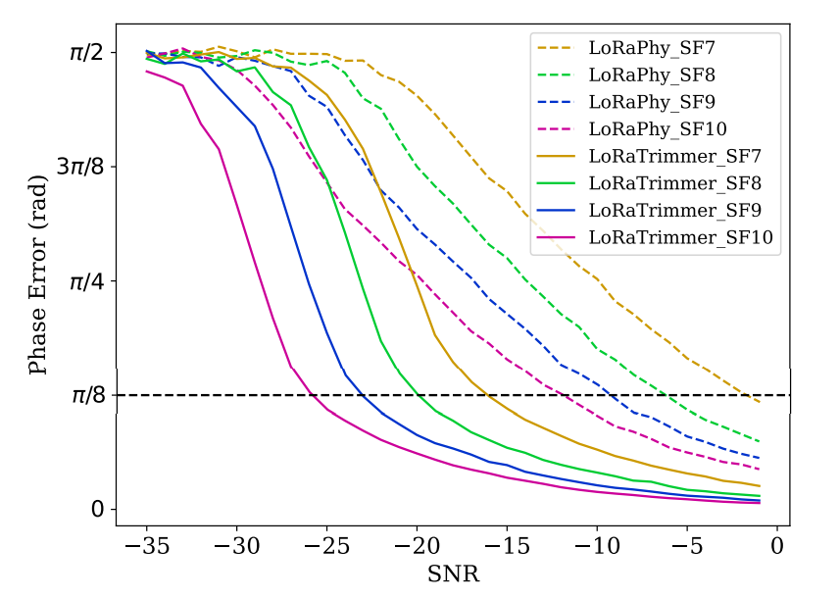
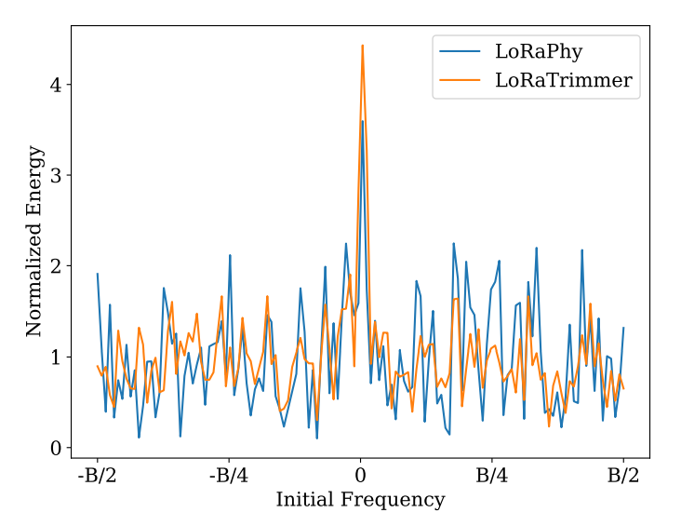
Evaluations
Accurate Phase Estimation
Sharp Power Peak

Slide 14
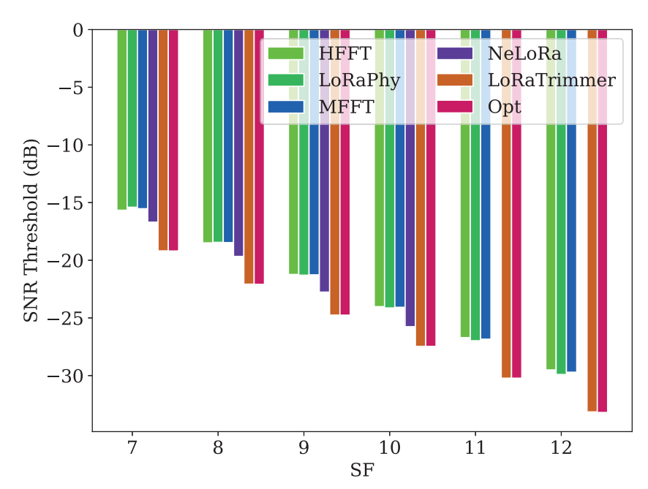
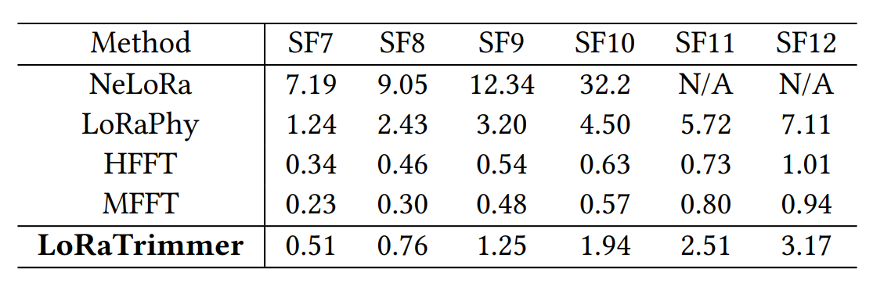
Evaluations
Low Computational Overhead
Real-time Demodulation
Lowest SNR Threshold

